Slide 1

DATA ANALYSIS AND ESSENTIALS
FINAL REVIEW | DAE CORNERSTONE PROJECT
Web Scraping & Product Price Analysis System
Department of Artificial Intelligence & Machine Learning
Presented By
G. Prem Sagar – 25B11AI344
K. Sri Durga Reddy – 25B11AI511
G. Pardhiva Sai – 25B11AI346
K. Anushka – 25B11AI535

Slide 2

AGENDA
Abstract
Introduction
Existing System & Limitations
Proposed System
Problem Statement & Objectives
Dataset Description
Requirements & Workflow
Methodology
Output Screenshots
Limitations & Future Scope
Conclusion & References

Slide 3
ABSTRACT
The Web Scraping & Product Price Analysis System is a Python-based data analytics project. It collects product names, prices and ratings from the Books to Scrape practice website using BeautifulSoup.
The extracted data is cleaned and structured using Pandas, stored in CSV format, and analyzed for price and rating patterns.
Results are visualized using Matplotlib and presented through a Flask web interface that displays the products and analysis results.

Slide 4
INTRODUCTION
Product information on web pages is available as semi-structured HTML data.
Manually collecting names, prices and ratings is repetitive and inefficient.
Raw scraped information needs cleaning and structuring before analysis.
Price and rating comparisons are difficult to perform directly from web pages.
A simple automated pipeline can convert web data into analysis-ready records.
The project connects scraping, preprocessing, analysis, visualization and web presentation.

Slide 5
EXISTING SYSTEM
Product information is collected manually or viewed directly from web pages.
Raw webpage data is not immediately suitable for analysis.
Name, price and rating appear as separate HTML elements.
Comparing multiple products requires repeated manual effort.
Data must be cleaned and converted into proper numeric fields.
Results are harder to understand without tables and visualizations.

Slide 6
LIMITATIONS OF EXISTING SYSTEM
Manual collection of product data is time-consuming.
Repeated copying can introduce data-entry errors.
Raw HTML content needs preprocessing before analysis.
Missing or inconsistent values may affect the final dataset.
Price and rating relationships are difficult to inspect manually.
Changes in web-page structure may break scraping selectors.
Without visualization, extracted data is less useful for quick comparison.

Slide 7
PROPOSED SYSTEM
Scrape product name, price and rating using BeautifulSoup.
Store extracted records in a Pandas DataFrame and CSV file.
Clean and normalize text and numeric fields.
Perform price comparison and rating-versus-price analysis.
Generate bar charts and scatter plots using Matplotlib.
Provide a Flask interface for product display and analysis results.
Support search, refresh and CSV download in the web interface.

Slide 8
PROBLEM STATEMENT
Product details on web pages are semi-structured HTML data.
Manual collection of names, prices and ratings is repetitive and inefficient.
Raw scraped data needs cleaning before it can be analyzed.
Comparing price and rating directly on web pages is difficult.
PROBLEM
Manual collection
Repetitive and error-prone
NEED
Automated pipeline
Scrape, clean and structure data
SOLUTION
Scrape + analyze
BeautifulSoup, Pandas, Flask

Slide 9
PROJECT OBJECTIVES
Acquire – scrape product name, price and rating from web pages.
Store – maintain structured records in Pandas and CSV.
Clean – normalize fields so they can be analyzed consistently.
Analyze – perform price comparison and rating analysis.
Visualize – create bar charts and scatter plots with Matplotlib.
Present – show products and results through a Flask interface.

Slide 10
DATASET DESCRIPTION
Source: Books to Scrape – a practice website for web scraping
Site size: 1,000 books across 50 pages
Working sample: 20 book records
Attributes: 3 fields – Product Name, Price, Rating
Data type: Text and numeric product data
Price: in pounds (£) | Rating: 1–5 scale
Example record: “A Light in the Attic” – £51.77 – Rating 3

Slide 11
DATA DICTIONARY
Field | Type | Meaning
Product Name | Text | Book title collected from the page
Price | Numeric | Product price in pounds (£)
Rating | Integer | Rating on a 1–5 scale
Example record: “A Light in the Attic” – £51.77 – Rating 3

Slide 12
REQUIREMENTS
Hardware Requirements
Standard laptop / desktop
Internet connection for web-page access
Software Requirements
Python – programming language
BeautifulSoup – web scraping
Pandas – data handling and cleaning
Matplotlib – data visualization
Flask – web interface
CSV – dataset storage

Slide 13
PROJECT WORKFLOW
1
Open Web Page
2
Scrape Data
3
Build DataFrame
4
Save to CSV
5
Clean & Validate
6
Analyze
7
Visualize
8
Flask Interface

Slide 14
METHODOLOGY – MODULES 1 TO 4
Module 1 – Web Data Collection: identify required HTML elements and scrape name, price and rating using BeautifulSoup.
Module 2 – Data Structuring: store records in a Pandas DataFrame and save in CSV format.
Module 3 – Data Cleaning: normalize scraped text and numeric values and validate fields.
Module 4 – Data Preparation: convert price and rating into analysis-ready numeric fields.

Slide 15
METHODOLOGY – MODULES 5 TO 8
Module 5 – Exploratory Data Analysis: compare price levels and inspect rating-versus-price patterns.
Module 6 – Product Analysis: perform price comparison and examine how ratings relate to prices.
Module 7 – Data Visualization: bar charts for price comparison and scatter plots for rating vs price.
Module 8 – Web Presentation: present products and analysis through Flask with search, refresh and CSV download.

Slide 16
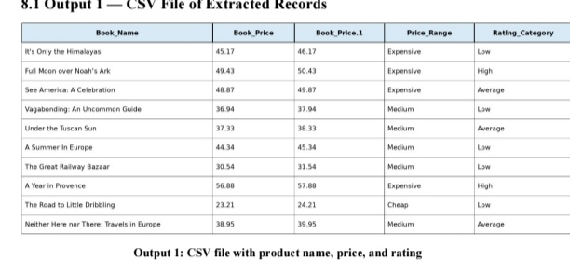
SCREENSHOTS OF OUTPUTS
Insert screenshot here
Scraped Data (DataFrame / CSV)

Slide 17
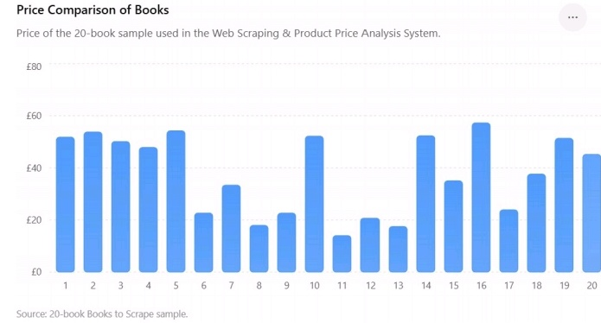
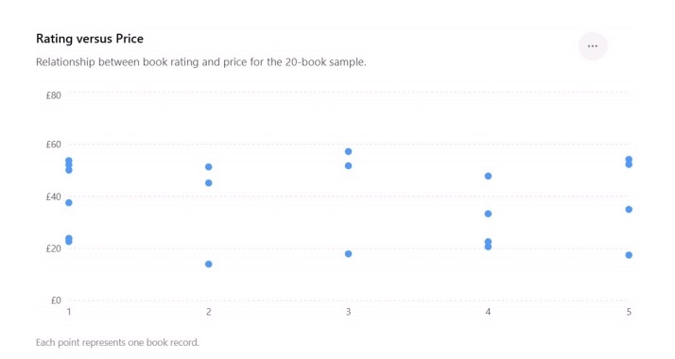
SCREENSHOTS OF OUTPUTS
Insert screenshot here
Price Comparison Bar Chart
Insert screenshot here
Rating vs Price Scatter Plot

Slide 18
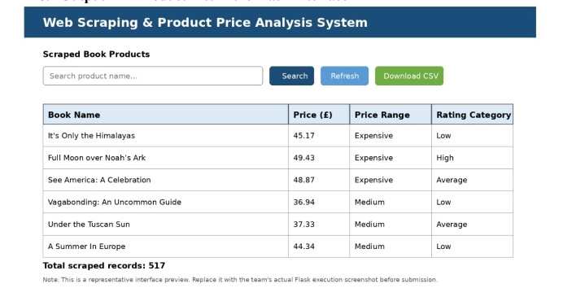
SCREENSHOTS OF OUTPUTS
Insert screenshot here
Flask Web Interface

Slide 19
LIMITATIONS & FUTURE SCOPE
Current Limitations
Working sample is only 20 records.
Books to Scrape is a practice site; its prices and ratings are not real market signals.
Web-page changes can break scraping selectors.
Future Scope
Expand the dataset to more pages and categories.
Strengthen validation for changing web structures.
Improve dashboard interactivity and add richer analytics.

Slide 20
CONCLUSION
The project demonstrates a complete web-scraping and product-analysis pipeline using Python.
BeautifulSoup collects product data from a practice website.
Pandas and CSV provide structured storage and preprocessing.
Matplotlib supports product price and rating analysis.
Flask provides a simple web-based presentation layer.
The workflow connects data collection with practical data analytics.

Slide 21
REFERENCES
Books to Scrape – practice web-scraping website (books.toscrape.com).
Beautiful Soup Documentation – HTML parsing and data extraction.
Flask Documentation – application structure, routes and templates.

Slide 22

Thank You

